Slide 1
Deutschland Bier, Wurst und Schwachstellen
Open Identity Summit 2024

Slide 2
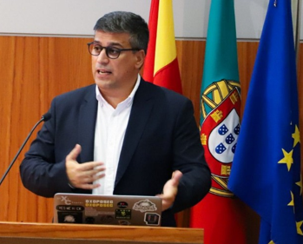
$whoami
Pedro Vieira
Security Engineer
Certified Ethical Hacker
Degree at University of Minho

Slide 3
Disclaimer & Laws

Slide 4

Disclaimer Boring but necessary
Information in this presentation is intended for educational and awareness purposes only.
Live presentation. Not a controlled environment and some contents may be inappropriate for some users.
I accept no responsibility in any kind for the use, misuse, downloading, viewing in whatever way the links in this presentation.
This presentation is not related to my work or employer.

Slide 5
Disclaimer Avoid illegal activities
Some links, websites, software or other items listed may or may not be legal, illegal, a felony, misdemeanor, or worse, in your country.
Please make sure that you are allowed to browse the websites, download links and software BEFORE USING!
Ignorance about laws or rules is no excuse for illegal activities or wrongdoing.
Illegal activities may get you in trouble or arrested.
Always check what is legal, and what laws apply.

Slide 6
Laws Portuguese Law and Organizations
Laws
Diário República Eletrónico (link)
ANACOM (link)
Organizations
CNCS – Centro Nacional de Cibersegurança (link)
Incident Notification (link)
CERT.PT (link)
Unidade Nacional de Combate ao Cibercrime e à Criminalidade Tecnológica (UNC3T) (link)
Ministério Público (link)

Slide 7
Agenda
Vulnerability
Germany Landscape
Common Attack Vectors

Slide 8
Vulnerability
Definition and Statistics

Slide 9

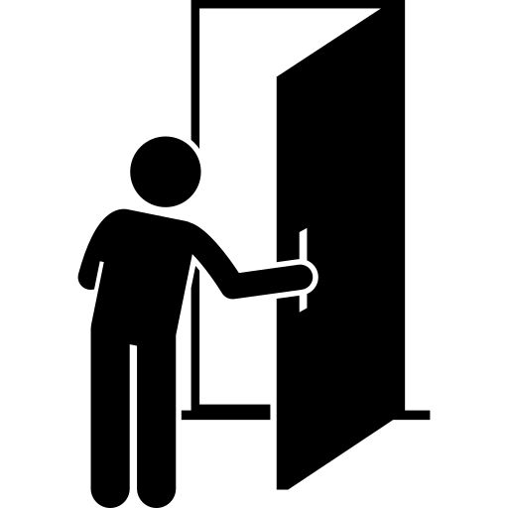
Vulnerability Vulnerability vs incident
Vulnerability
"A weakness in the computational logic (e.g., code) found in software and hardware components that, when exploited, results in a negative impact to confidentiality, integrity, or availability."
National Vulnerability Database - https://nvd.nist.gov/vuln
Vulnerability | Incident
Open door
Unauthorized access
images: Flaticon.com
Notes:
Vulnerability - Known weakness in the system that can be exploited
Incident - Exploitation of the existing vulnerability

Slide 10
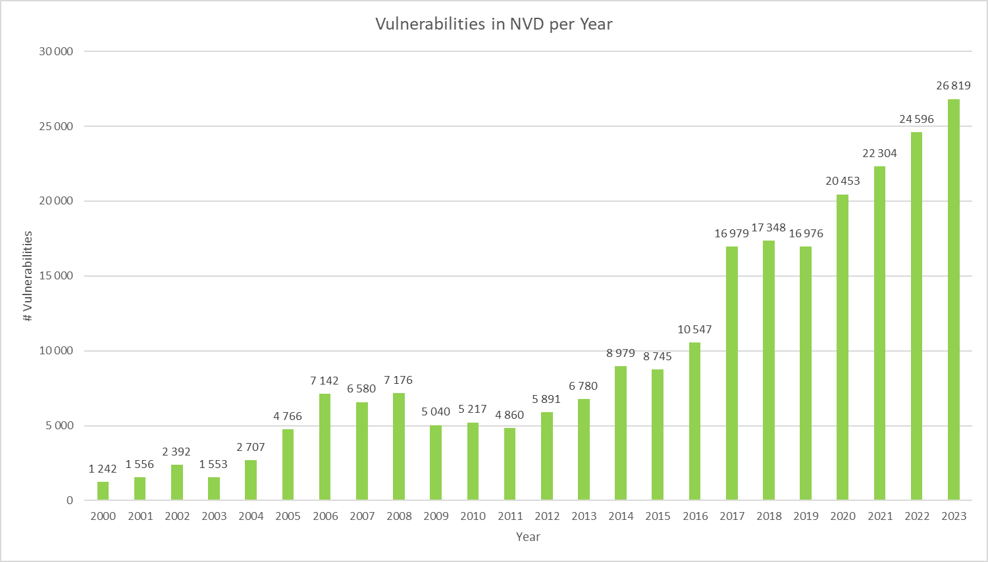
Vulnerability Statistics by Year
Total known vulnerabilities
283.154

Slide 11
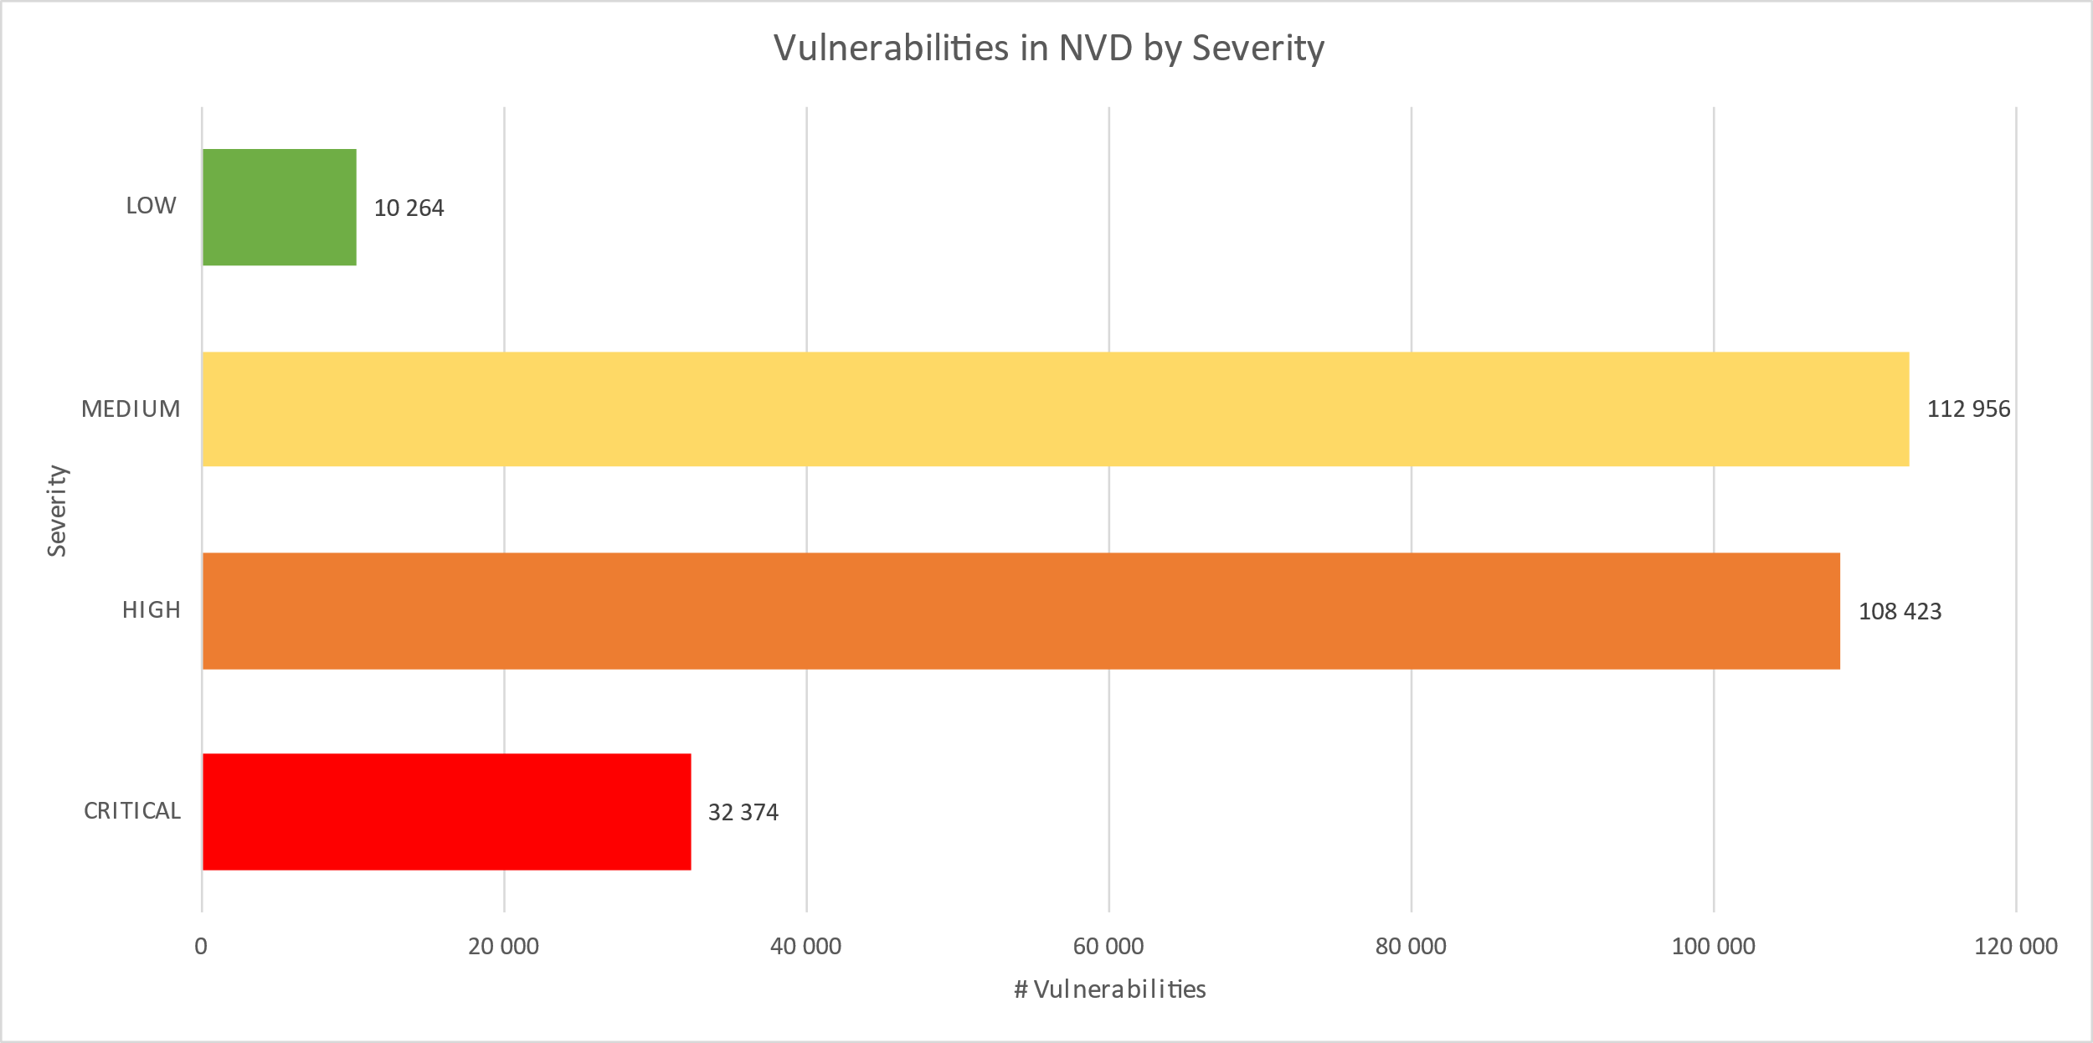
Vulnerability Statistics by Severity
Notes:
High and Critical amounts to more than 53% of all vulnerabilities

Slide 12
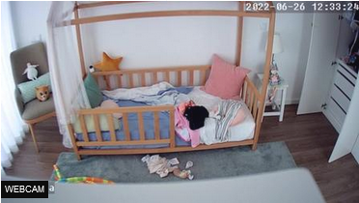
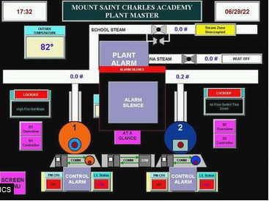
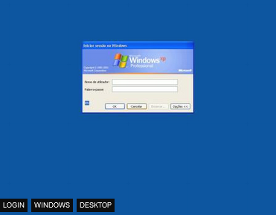
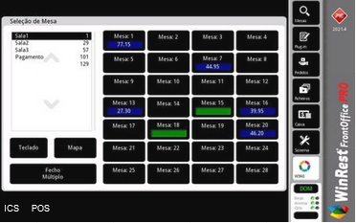
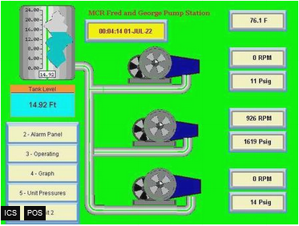
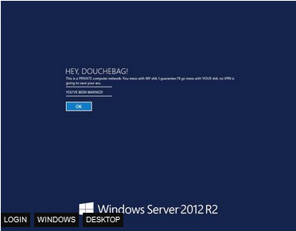
Vulnerability Examples from Shodan.io
Default/No Password | Industrial Control Systems | Vulnerable Systems

Slide 13
German landscape

Slide 14
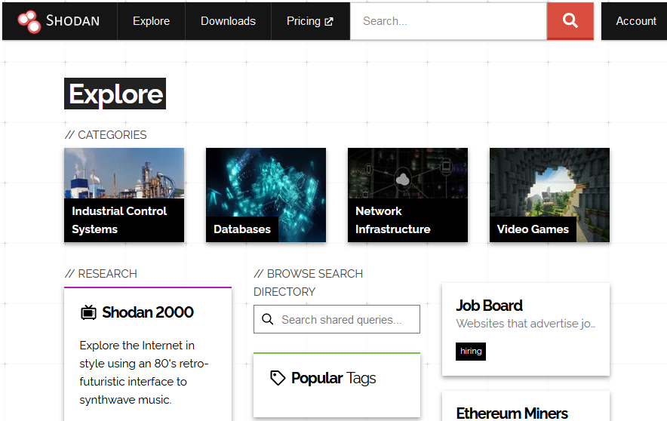
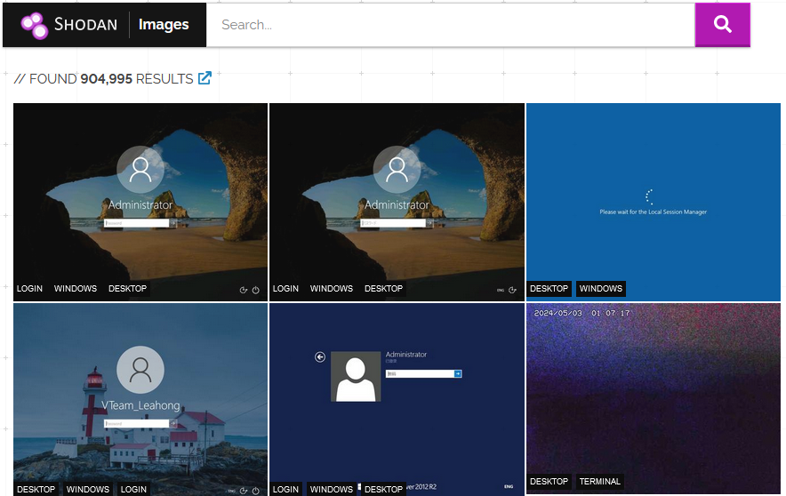
Germany Shodan.io - Search Engine for Internet Of Things
Explore | Images
Notes:
https://www.dontclickthis.run/shodan-hackers-best-friend/
https://github.com/lothos612/shodan?ref=dontclickthis.run

Slide 15
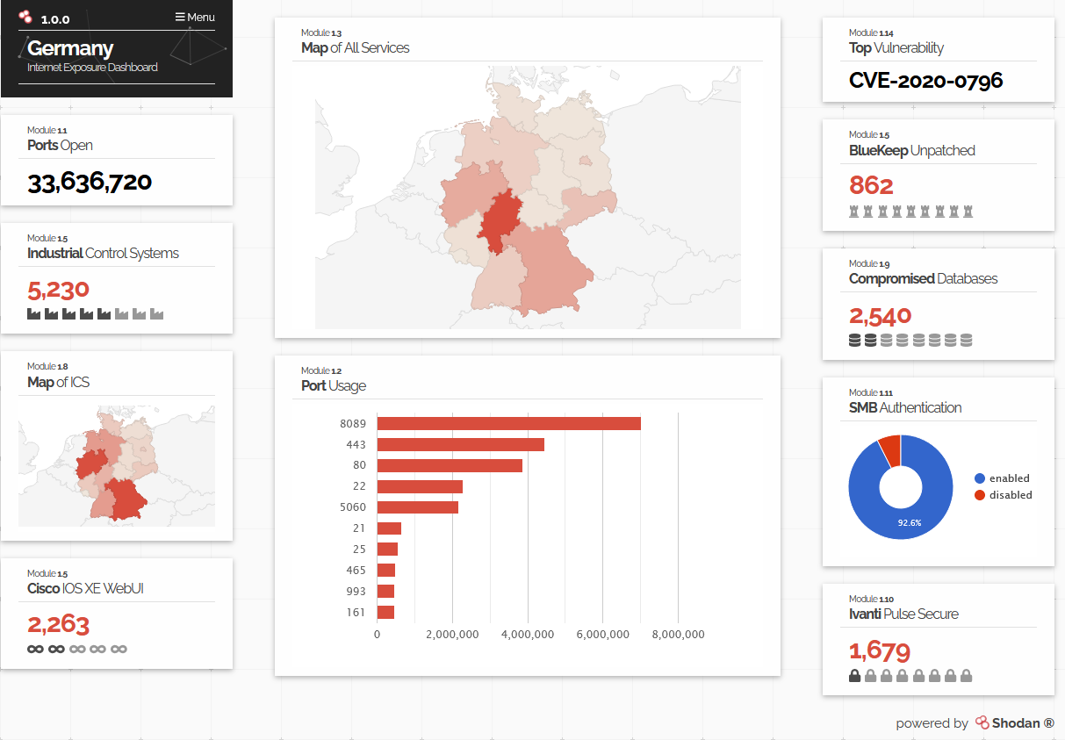
Germany Shodan.io - Search Engine for Internet Of Things
Internet Exposure Observatory
Notes:
https://exposure.shodan.io/#/DE

Slide 16
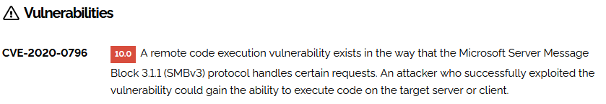
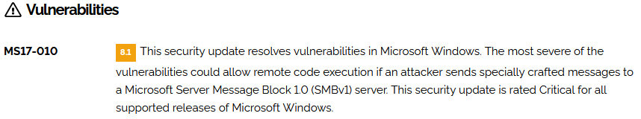
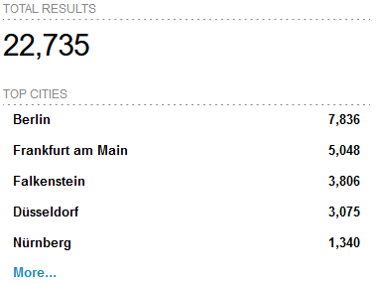
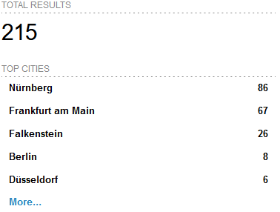
Germany Shodan.io - Search Engine for Internet Of Things
Top in Germany - SMBGhost - CVE-2020-0796 | EternalBlue - MS17-010 - CVE-2017-0144
Notes:
https://www.shodan.io/search?query=vuln%3ACVE-2020-0796+country%3Ade
https://www.shodan.io/search?query=vuln%3Ams17-010+country%3Ade

Slide 17
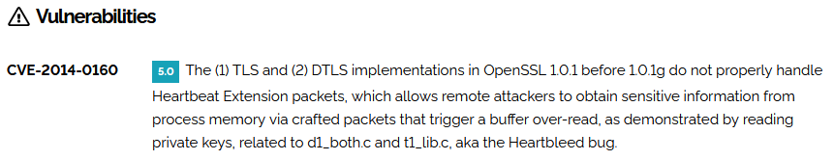
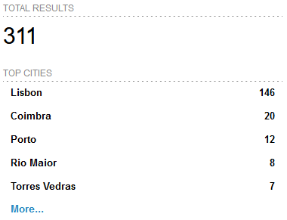
Germany Shodan.io - Search Engine for Internet Of Things
Heartbleed - CVE-2014-0160 | Logjam - CVE-2022-32548
Notes:
https://www.shodan.io/search?query=vuln%3ACVE-2014-0160+country%3Ade
https://www.shodan.io/search?query=vuln%3ACVE-2020-0796+country%3Apt

Slide 18
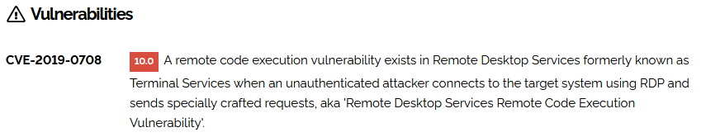
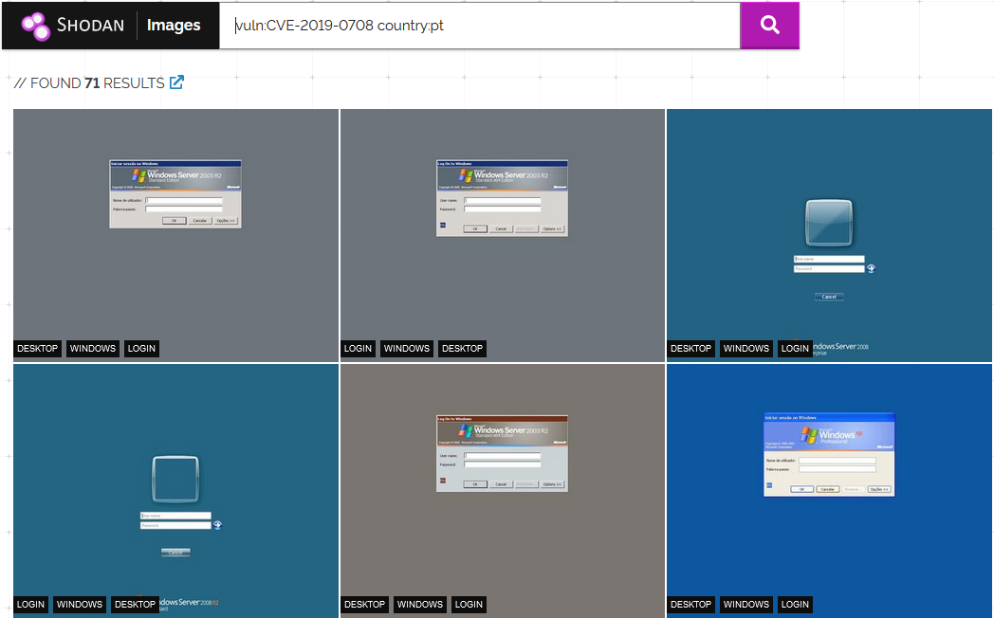
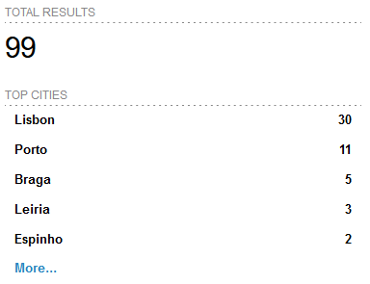
Germany Shodan.io - Search Engine for Internet Of Things
BlueKeep - CVE-2019-0708
Notes:
https://www.shodan.io/search?query=vuln%3ACVE-2019-0708+country%3Ade

Slide 19
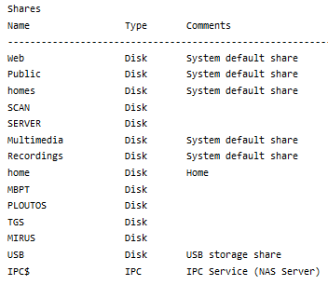
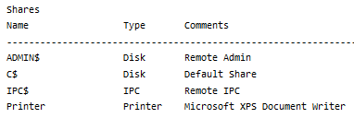
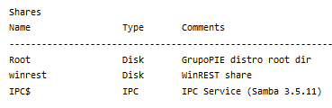
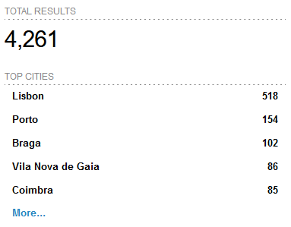
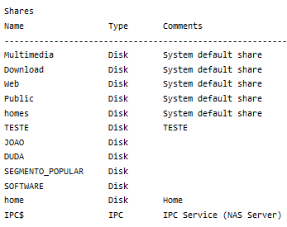
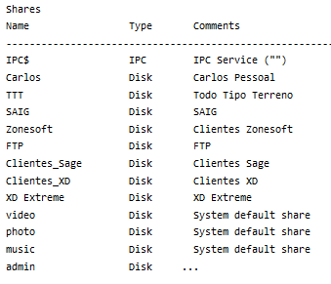
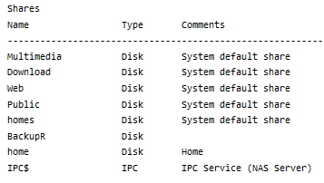
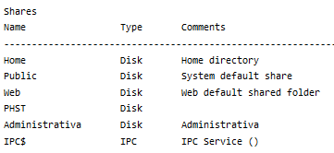
Germany Shodan.io - Search Engine for Internet Of Things
Shared Folders
Notes:
https://www.shodan.io/search?query=country%3Apt+port%3A%22445%22+Authentication%3A+%22disabled%22

Slide 20
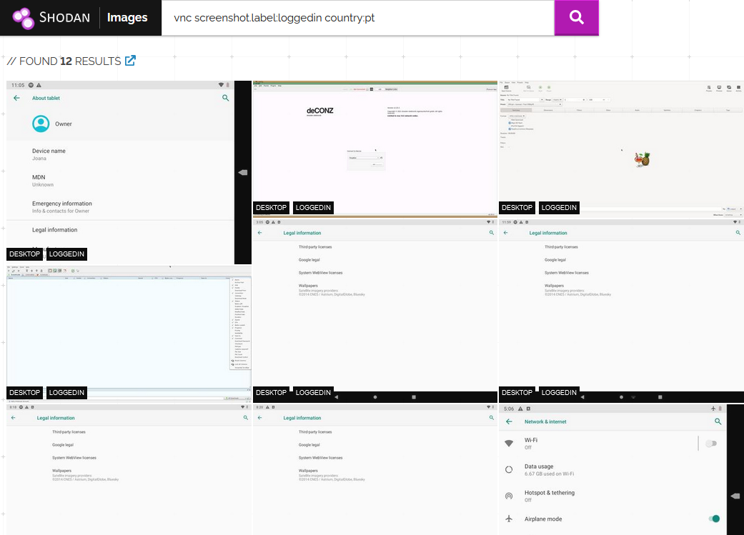
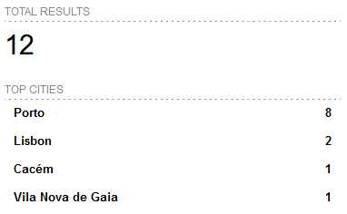
Germany Shodan.io - Search Engine for Internet Of Things
Logged In Remote Access
Notes:
https://images.shodan.io/?query=vnc+screenshot.label%3Aloggedin+country%3Ade

Slide 21
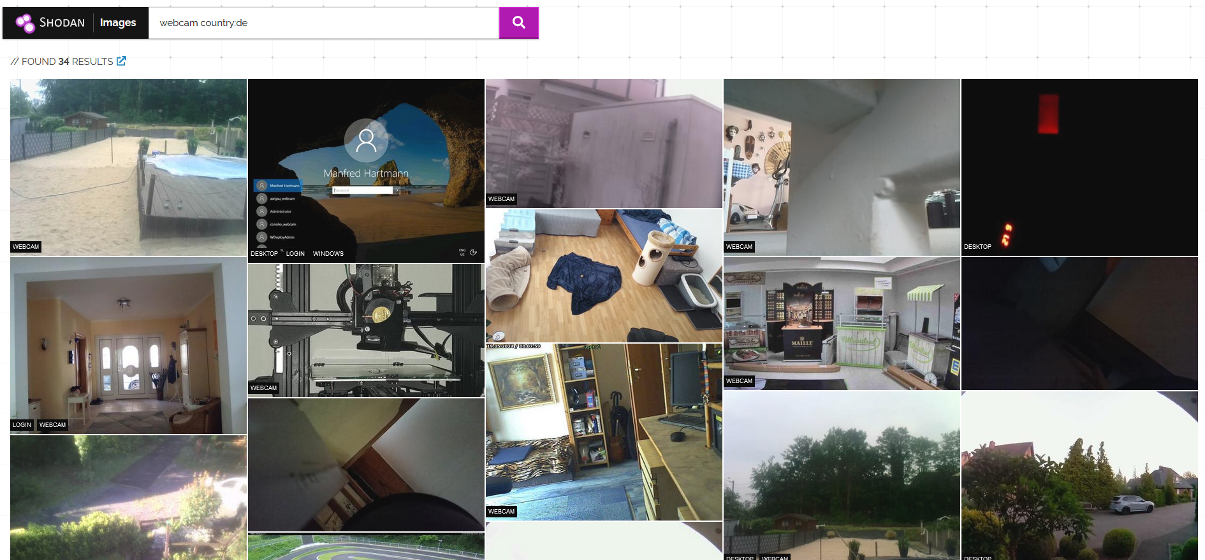
Germany Shodan.io - Search Engine for Internet Of Things
Webcam
Notes:
https://images.shodan.io/?query=has_screenshot%3Atrue+country%3A%22DE%22+-screenshot.label%3Adesktop

Slide 22
Q&A

Slide 23
Common Attack Vectors
Easy-Peasy

Slide 24
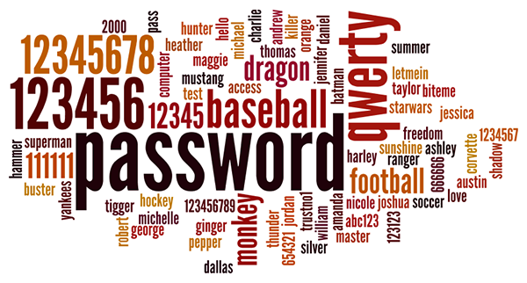
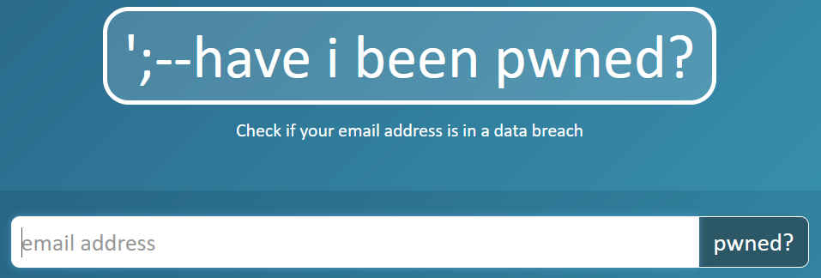
Common Attack Vectors Credentials
Insecure | Compromised/Leaked
No password Default credentials (admin/admin) Weak passwords Reused passwords | Hacked legitime sites leaked user information and credentials Mother of all breaches reveals 26 billion records
Notes:
rockyou.txt contains 14,341,564 unique passwords, used in 32,603,388 accounts.
https://www.troyhunt.com/the-773-million-record-collection-1-data-reach/

Slide 25
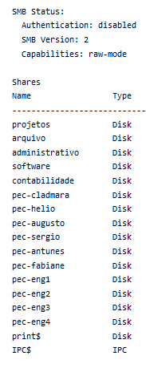
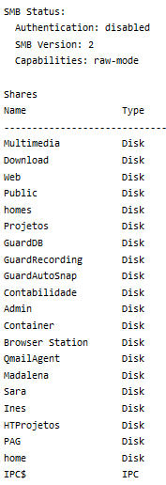
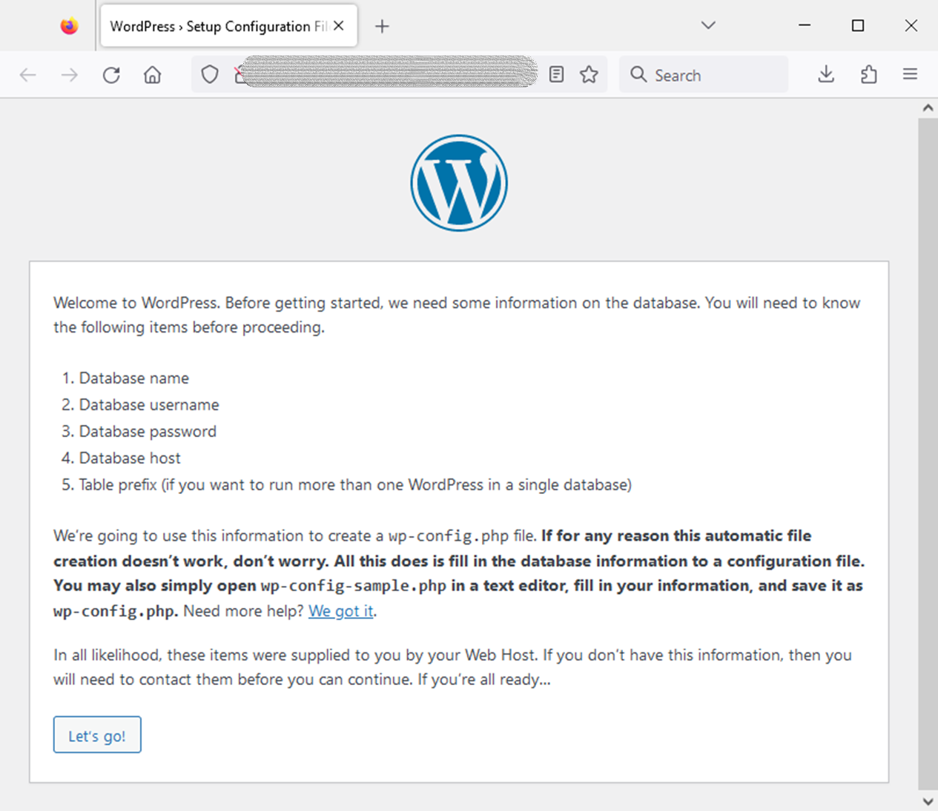
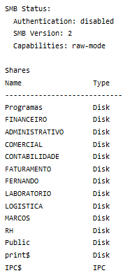
Common Attack Vectors Misconfiguration
Shared Folder – Authentication disabled | WordPress site – Configuration available
Notes:
https://www.shodan.io/search?query=contabilidade+port%3A445
Shared folder
Authenticated disabled
World accessible

Slide 26

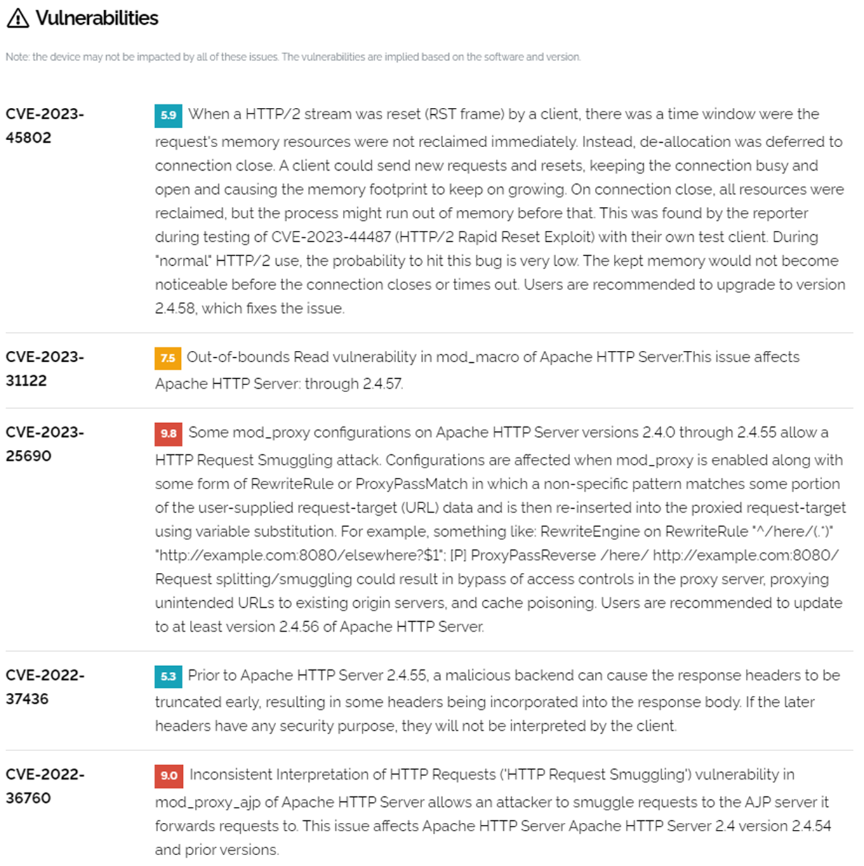
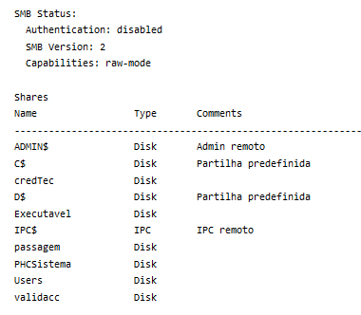
Common Attack Vectors Software Vulnerabilities
Shared Folder - Remote Code Execution | Website – Several vulnerabilities

Slide 27
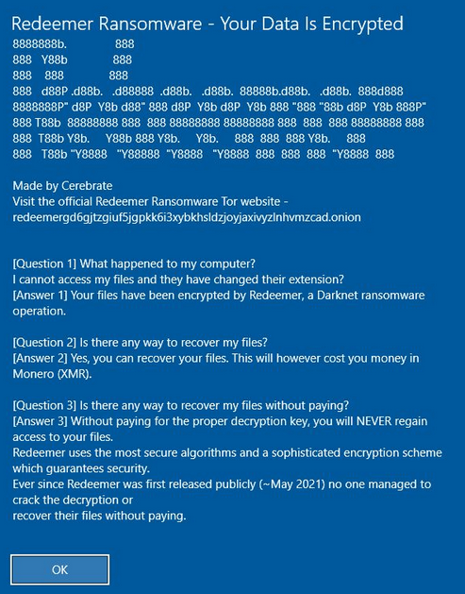
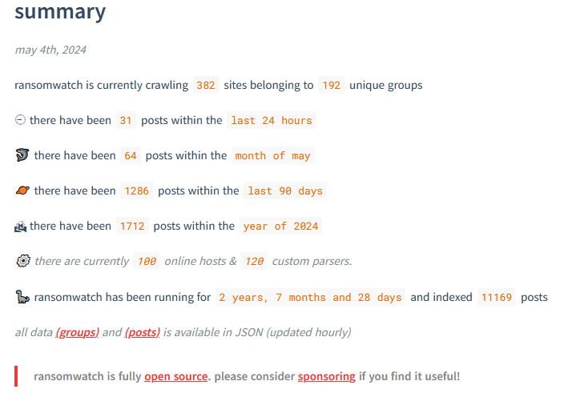
Common Attack Vectors Malware - Ransomware
Redeemer Ransomware | Ransomwatch
Notes:
https://images.shodan.io/?query=ransomware
https://www.nomoreransom.org/en/index.html
https://www.bleepingcomputer.com/news/security/french-hospital-chc-sv-refuses-to-pay-lockbit-extortion-demand/
https://www.darkreading.com/cyberattacks-data-breaches/hubris-may-have-caused-lockbit-s-downfall

Slide 28
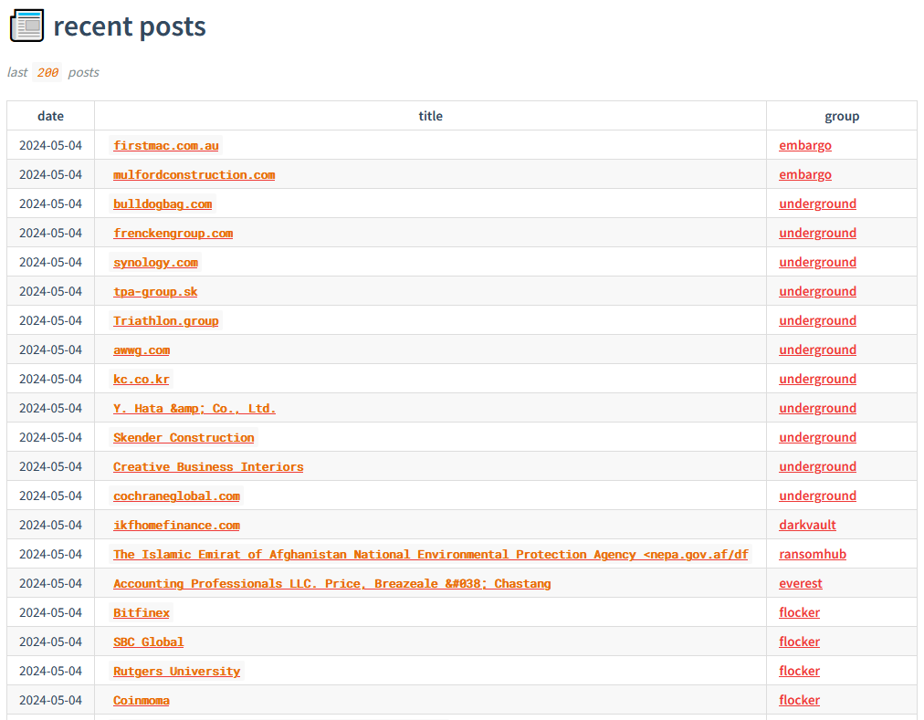
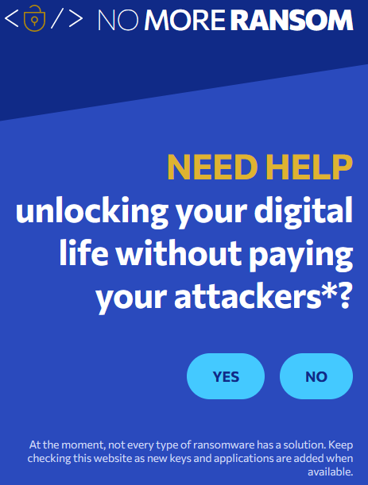
Common Attack Vectors Malware - Ransomware
Ransomwatch | NoMoreRansom
Notes:
https://ransomwatch.telemetry.ltd/#/README
https://ransomwatch.telemetry.ltd/#/recentposts

